Slide 1
Modern Analytics Academy “Vignettes”
Follow up to Modern Analytics Academy: https://aka.ms/maa
Topical sessions that addresses:
New features and how to use them
Frequent questions we receive
Updates to a previous session

Slide 2
Modern Analytics Academy “Vignettes”
Schema Design in SQL Pools
https://aka.ms/maa
Mike Shelton
Cloud Solution Architect

Slide 3
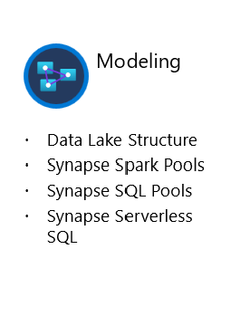





Academy Sessions
Acquisition & Storage
Modeling
Pipelines
Security & Governance
Visualization
Azure Data Lake
Azure Cosmos DB
Azure Event Hubs
Synapse Link
Data Lake Structure
Synapse Spark Pools
Synapse SQL Pools
Synapse Serverless SQL
Azure Data Factory
Synapse Pipelines
Power BI Dataflows
Azure Stream Analytics
Auditing
Security
Azure purview
Power BI
Paginated Reports
Power BI Embedded

Slide 4
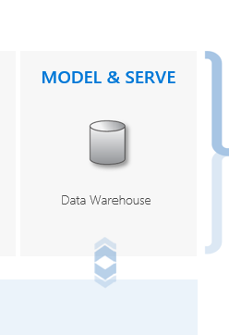




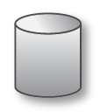
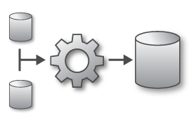
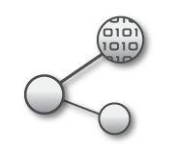
Modern Analytics in Azure
LOB
INGEST
EXPLORE
PREP & TRAIN
MODEL & SERVE
CRM
BI + Reporting
Graph
Advanced Analytics
Query All Data
Analytics Engines
Data Warehouse
Image
Real Time Analytics
Data Orchestration and Monitoring
Social
STORE
Big data store
IoT
METADATA MANAGEMENT & GOVERNANCE
Cloud

Slide 5
Synapse SQL Pools Schema Design
Data warehouse
Simplifying access to the data for reporting and analytics
Increases performance
Dimensional modeling
Business subject orientated
Conforming
Integrating data together
Cleaning

Slide 6
Entity relationship (3NF) and Dimensional Modeling
Entity Relationship (ER) – (Third Normal Form - 3NF)
Transactional processing applications data models
Normalized to provide efficient data inserts and updates
Reduce data redundancy
Complex for end users to query
Dimensional modeling
Analytical application data models
Used in Data warehouse modeling
Used in analytical tools such as Power BI
Denormalized to provide simplified data models supporting aggregations over large volumes of data
Support end user queries

Slide 7
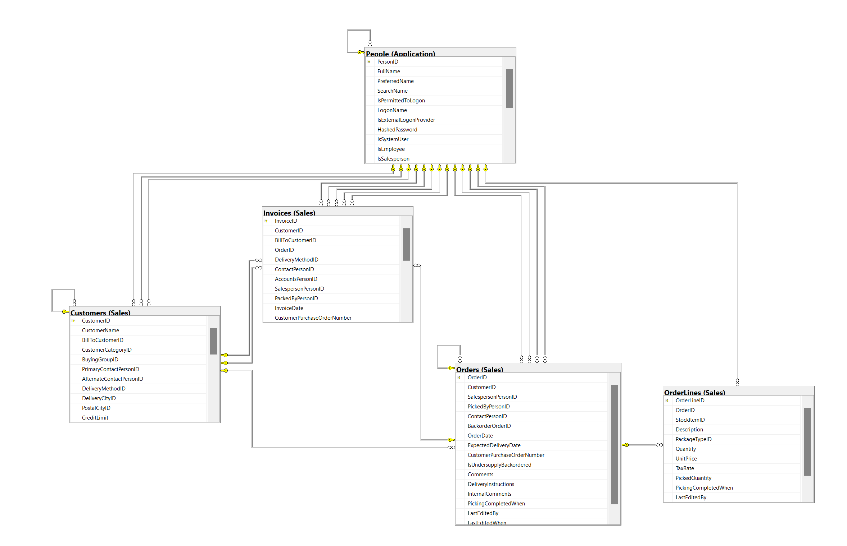
Wide World Importers – ER (3NF) Diagram - Orders

Slide 8
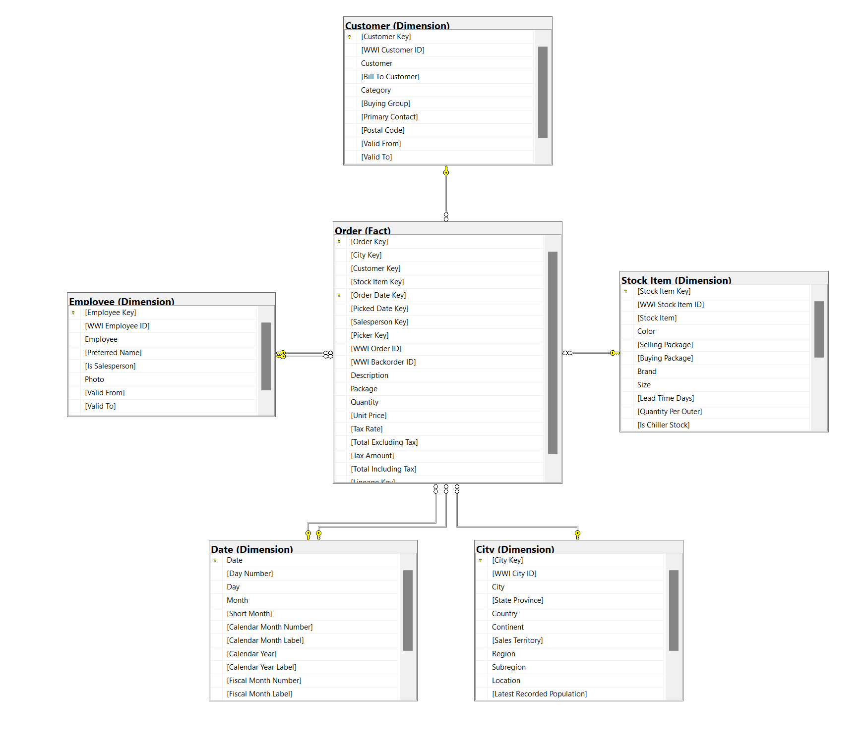
Wide World Importers Dimensional Model - Orders

Slide 9
Data warehouse schema design – Dimensional Model
Fact tables
Holds measures for aggregation
Often the largest table in the model
Dimension tables
Descriptive attributes used for filtering and grouping fact table measures. Dimension tables describe entities.
Star schema
Data warehouse modeling approach used to model the schema.

Slide 10
Wide World Importers Dimensional Model

Slide 11
Wide World Importers Dimensional Model

Slide 12
Dimensions
Surrogate keys are unique keys defined for the purpose of the dimensional model to create relationships between the dimension tables and the fact tables
Business Keys become and attribute of the dimension table
Role-playing dimensions – Same dimension table used for different purposes
Slowly changing dimensions – data in dimension tables often change slower than data in the fact table. Techniques exist to address how various data changes to dimension data can be applied.
Snowflake dimension
An approach used to leverage normalization in a dimension table
Additional work may be needed in analytical tools to consolidate the tables to create visualizations or other analytical views

Slide 13
Fact tables
Facts – Measures
Historical in nature
Level of granularity – Grain – the level of detail stored. All data stored together should be stored at the same level
Keys mapping to dimension tables
Increasing data volume
Factless fact tables – does not contain any measures

Slide 14
Wide World Importers Dimensional Model

Slide 15
Wide World Importers Dimensional Model

Slide 16
Wide World Importers Dimensional Model

Slide 17
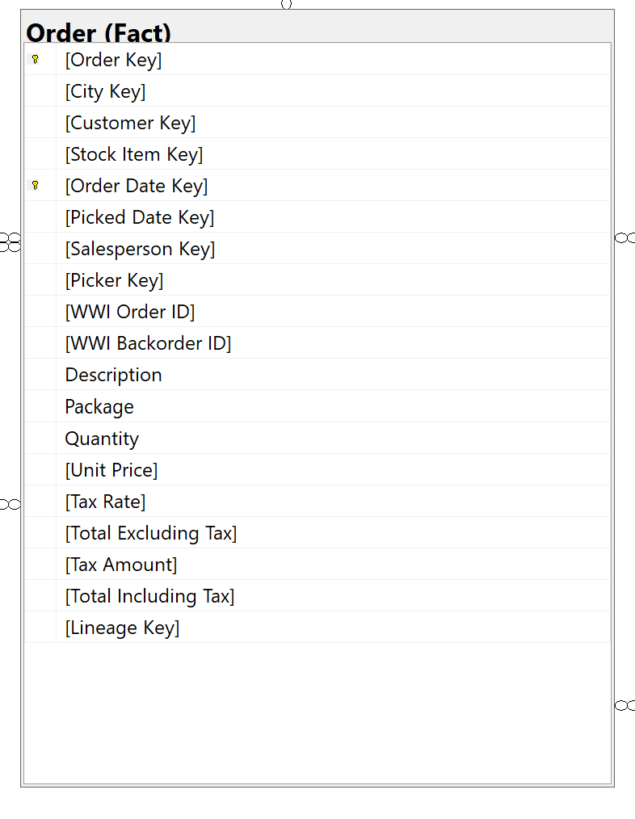
Wide World Importers Dimensional Model

Slide 18
Wide World Importers Dimensional Model

Slide 19
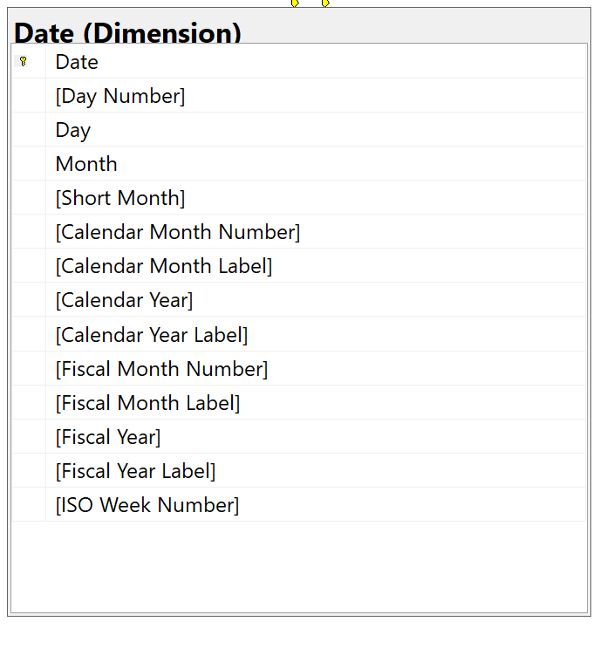
Wide World Importers Dimensional Model

Slide 20
Modern Analytics in Azure
LOB
INGEST
EXPLORE
PREP & TRAIN
MODEL & SERVE
CRM
BI + Reporting
Graph
Advanced Analytics
Query All Data
Analytics Engines
Data Warehouse
Image
Real Time Analytics
Data Orchestration and Monitoring
Social
STORE
Big data store
IoT
METADATA MANAGEMENT & GOVERNANCE
Cloud

Slide 21
Additional Resources
Understand star schema and the importance for Power BI - Power BI | Microsoft Docs
Design a multidimensional schema to optimize analytical workloads - Learn | Microsoft Docs
The Data Warehouse Toolkit: The Definitive Guide to Dimensional Modeling by Ralph Kimball

Slide 22
Future “Vignettes” topics
Synapse Data Explorer
Synapse Database templates
Synapse partition modeling
Dataverse

Slide 23
Thank you!
Modern Analytics Academy “Vignettes”
Schema Design in SQL Pools
https://aka.ms/maa

